Slide 1
Database Systems
Codd’s 12 Relational Database Rules (See Table 13.8 in Section 3.9)
Foundation: A system must manage DBs entirely through its relational capabilities.
Information
Guaranteed Access
Systematic Treatment of Null Values
Dynamic Online Catalog
Comprehensive Data Sublanguage
View Updating
High-Level Insert, Update, and Delete
Physical Data Independence
Logical Data Independence
Integrity Independence
Distribution Independence
Non-Subversion

Slide 2
Data vs. Information
Data – raw facts; not yet processed
  Building blocks of information
  Need to be formatted for storage, processing, and presentation
Information – processed data to reveal it’s meaning
  Produced by processing data
  From organization to data analysis
  Requires context
  Accurate, relevant, valid, and timely information is key to good decisions

Slide 3
Databases
Data management
  Discipline focused on the proper generation, storage, and retrieval of data
Database – shared, integrated computer structure that stores:
  End-user data – raw facts of interest to the user
  Metadata – data about data used to integrate and manage end-user data
    Describes data characteristics and the set of relationships
    Examples: data name, data type, data constraints
DBMS – Database Management System
  Collections of programs to manage the database structure and access

Slide 4
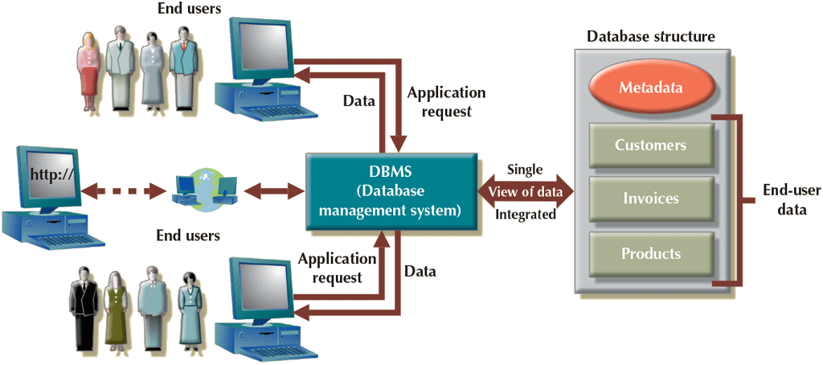
DBMS Role

Slide 5
DBMS Advantages
Improved data sharing
Improved data security
Better data integration
Minimized data inconsistency
Improved data access
Improved decision making
Increased end-user productivity

Slide 6
Important Terminology
Data Inconsistency – different versions of the same data exists in different places and yield different (inconsistent) results
Data quality – comprehensive approach to ensuring the accuracy, validity, and timeliness of data
Data integrity – data in the DB complies with all entity and referential integrity constraints (important concept this semester)
Query – question or task for the DB (in SQL Code)
  A specific request for data retrieval or manipulation
Ad hoc query – spur-of-the-moment query

Slide 7
Important Terminology
Data dictionary (Section 3.5)
  Stores metadata including data definition, characteristics, and relationships
  May include information about data external to the database
System catalog (Section 3.5)
  Detailed system data dictionary that describes all objects of the database

Slide 8
DBMS Functions
Data dictionary management
Data storage management
Data transformation and presentation
Security management
Multiuser access control
Backup and recovery management
Data integrity management
Database access languages and application development interfaces
Database communication interfaces

Slide 9
Why Not Just Use Files?
Structural dependence
  Dependence – access to data is dependent on its structure
  Independence – changes in the schema (structure) doesn’t affect data access
Data dependence
  Physical data format – how the computer organizes and stores the data
  Logical data format – how we view the data
  Dependence – data representation and manipulation are dependent on physical data storage characteristics
  Independence – changes in the physical data storage does not affect representation and manipulation

Slide 10
Data Redundancy
Same data stored unnecessarily at different places
Uncontrolled data redundancy may lead to
  Poor data security
  Data inconsistency
  Data entry errors
  Data integrity problems
  Data anomalies – not all changes in redundant data are made successfully
    Update – change in existing redundant data is not consistent
    Insertion – adding data into redundant locations is not consistent
    Deletion – deleting existing redundant data is not consistent

